Slide 1
SUPPLY CHAIN ECOSYSTEM SIMULATORS
Ecosystem of Applications to simulate and manage processes in supply chain

Slide 2
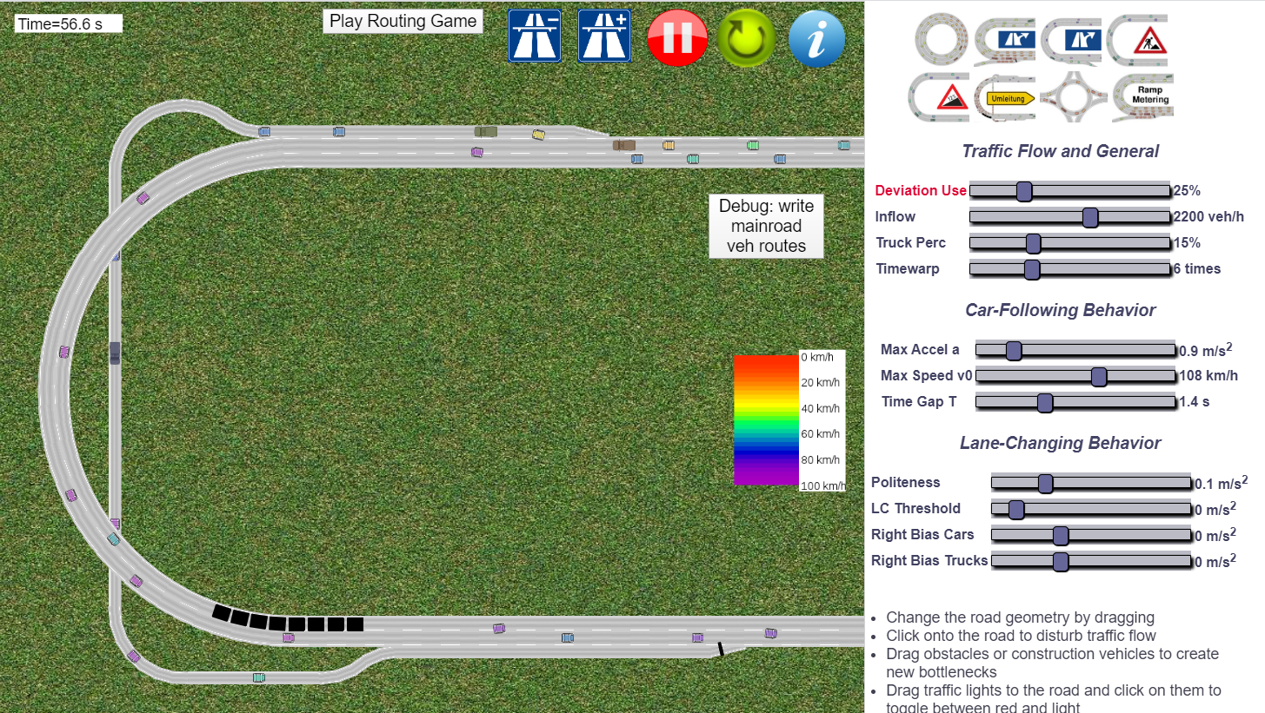

Some existing examples on car policies and behaviors
https://www.traffic-simulation.de/routing.html
http://volkhin.com/RoadTrafficSimulator/

Slide 3
OVERVIEW
Technical
Business
AGENTS
APPLICATION
OPERATORS
I/O in supply chain
supply chain service
application users
human behavior
processes
play scm
machines
strategies
simulation
dashboard

Slide 4

Developers internship
Storage

Slide 5
Developers internship
AGENTS
Storage

Slide 6
Developers internship
AGENTS
Storage

Slide 7
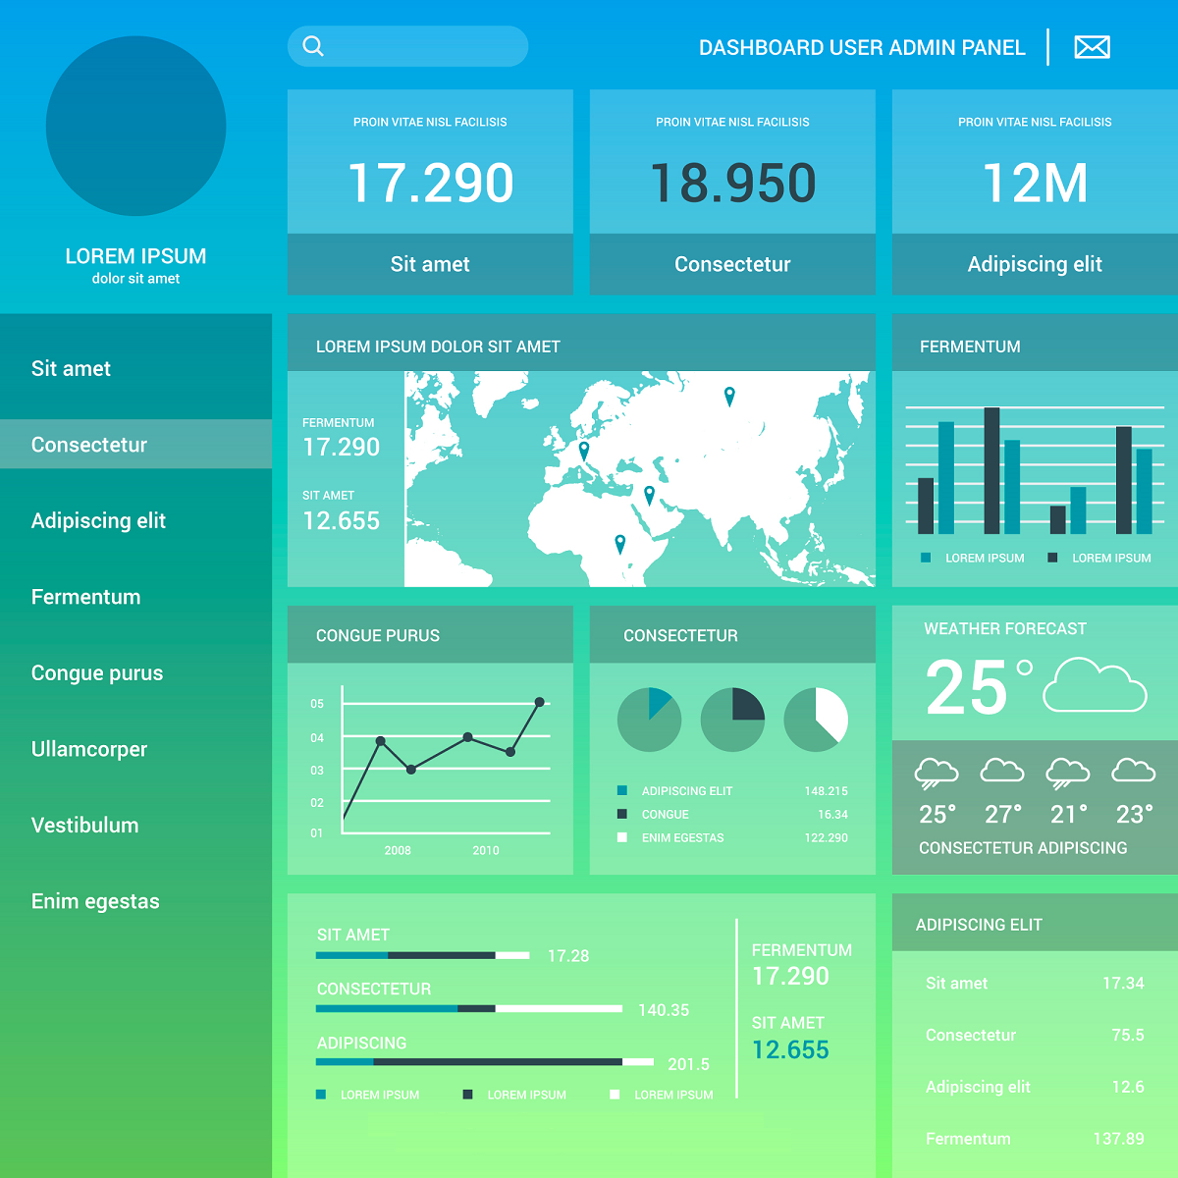
Developers internship
AGENTS
Web App Dashboard
Storage
PUSH data in real time and feed KPI on dashboard

Slide 8





Agents
Some examples

Slide 9





Agents
Agent create EVENTS

Slide 10
Agents
Agent create EVENTS in a TIMEFRAME

Slide 11
Agents
Agent create EVENTS in a TIMEFRAME in given CONDITIONS

Slide 12
Agents
Qualities

Slide 13
Agents
Skill
Speed
Budget
Qualities
Location

Slide 14
Agents
Skill
Speed
Budget
Qualities
Location
Behavior
Deliver
Buy
Sell

Slide 15
Developers internship
Web App Dashboard

Slide 16
Developers internship
Web App Dashboard
UI to configure agents Set properties and behavior
UI to manage processes and setup strategies Possibility to perform some actions on the system to affect internal and external agents and improve KPIs and capital.

Slide 17
Business analyst internship
Web App Dashboard

Slide 18
Business analyst internship
Web App Dashboard
Scenario Creator
Supply chain Manager

Slide 19
Business analyst internship
Web App Dashboard
Capital

Slide 20
Business analyst internship
Web App Dashboard
Capital
Process UI

Slide 21
Business analyst internship
Web App Dashboard
Capital
Process
External Agents
Human Resources
Machines

Slide 22
Business analyst internship
Web App Dashboard
Capital
Process
External Agents
Human Resources
Machines

Slide 23
Business analyst internship
Web App Dashboard
Capital
Process
External Agents
Human Resources
Machines

Slide 24
Business analyst internship
Web App Dashboard
Capital
Process
External Agents
Human Resources
Machines

Slide 25
Business analyst internship
Web App Dashboard
Capital
Process
External Agents
Human Resources
Machines

Slide 26
Business analyst internship
Capital
Process
Web App Dashboard
React to management
External Agents
Human Resources
Send Orders
React to management
React to management
Machines
React to management

Slide 27
Business analyst internship
Web App Dashboard
External Agents
Send Orders
Play as SC manager
React to management

Slide 28
Business analyst internship
Capital
Process
Web App Dashboard
React to management
Human Resources
Test Scenario Agent/Management
React to management
Machines
React to management

Slide 29
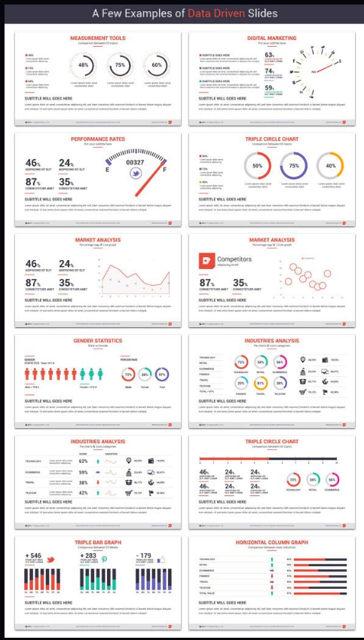
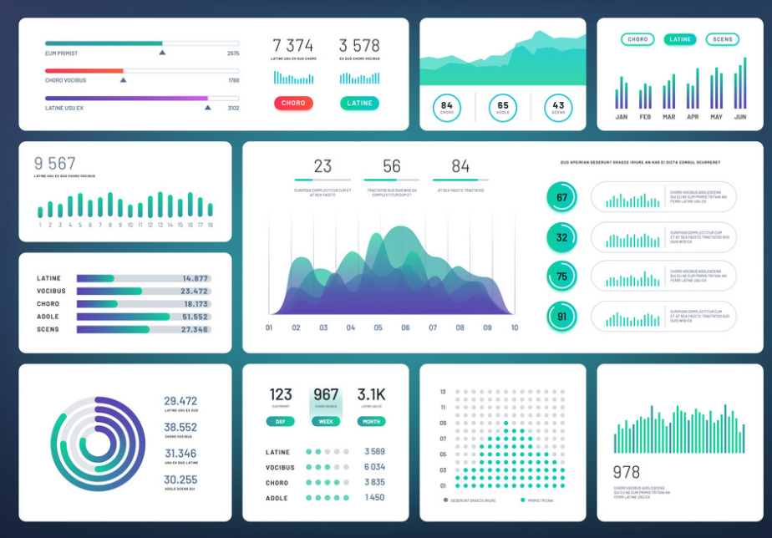
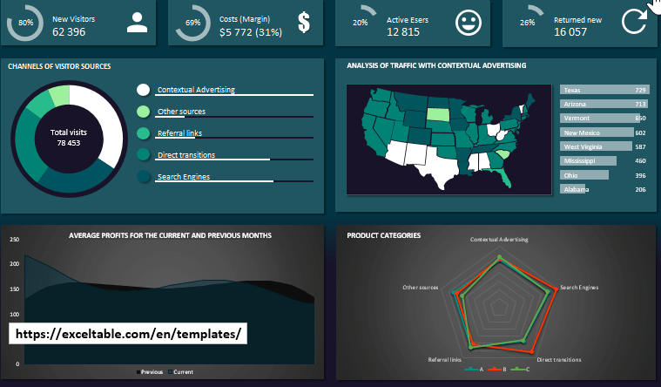
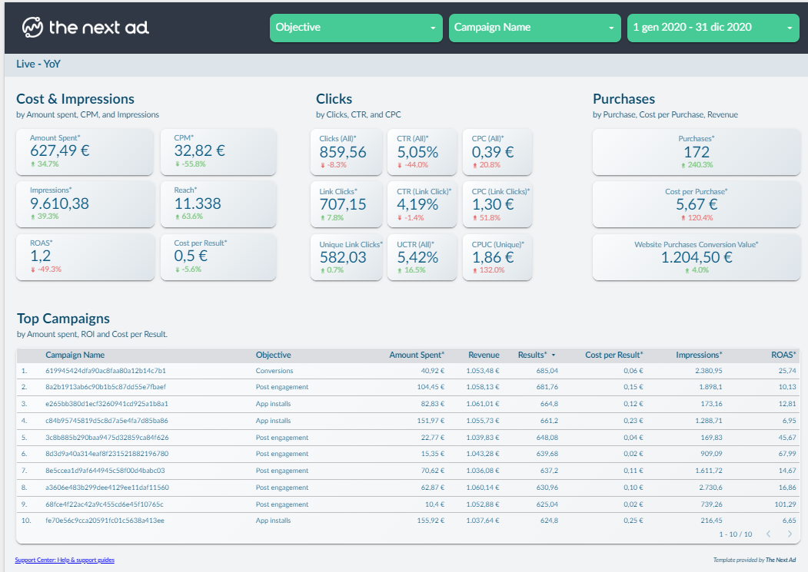
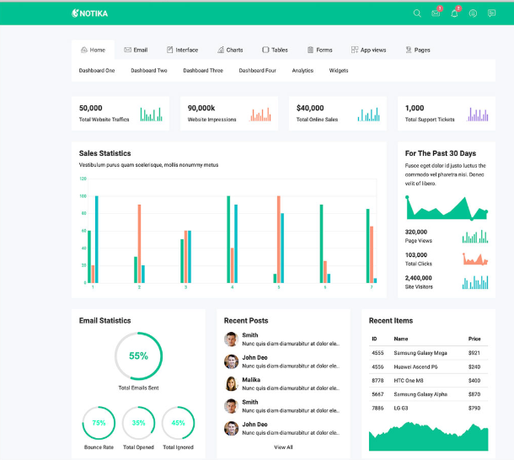
ECOSYSTEM of SCMS
Procurement
Demand Forecasting
Inventory
Warehouse
Freight Forwarding
Distribution

Slide 30



ABOUT THE PROJECTS
Data will be fictional
Strategies and process will implement SCM theories and best practice.
Code will be open source,
KNITS github account,
Public access under GNU
Products deployed on AWS
Activated on demand
Administration of cloud account KNITS

